Slide 1
QUESTION:
Why don’t we have good public transportation in Nashville?

Slide 2
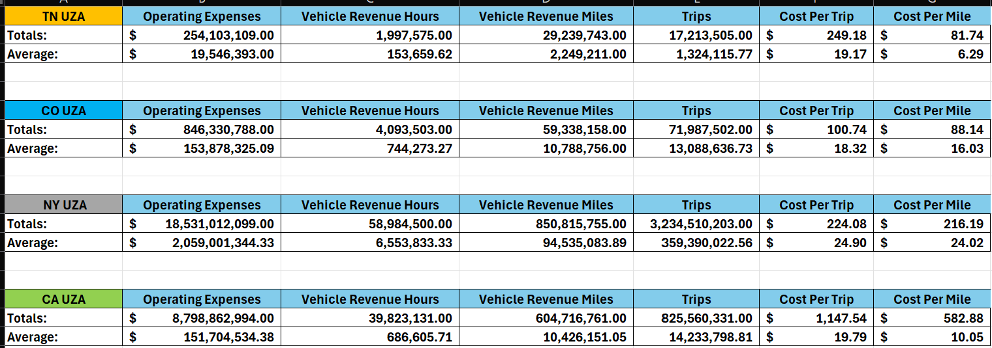
UZA’s by states I’ve visited and TN.
UZA’s are urban zone areas with population greater than 50,000. This helps me to compare apples to apples.
The data that I have are the topics shown below. This helps to calculate how effectively each UZA’s agencies are using their money.

Slide 3
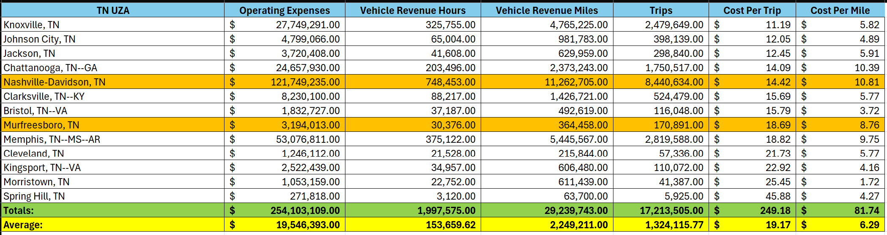
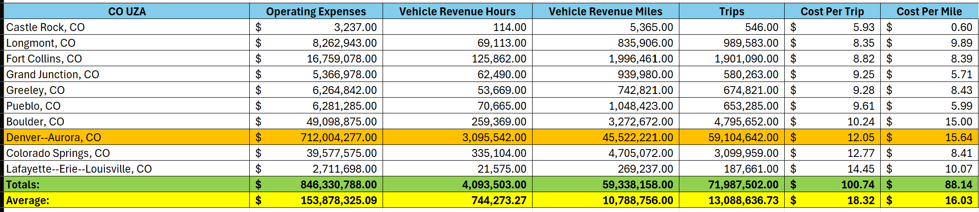
Here are the UZA’s that I’ve personally used by each state and where they rank within their respective states.
All of these graphs are sorted by Cost Per Trip.
I also want to provide insight on how complex the issue is and how much data is associated with this analysis.

Slide 4
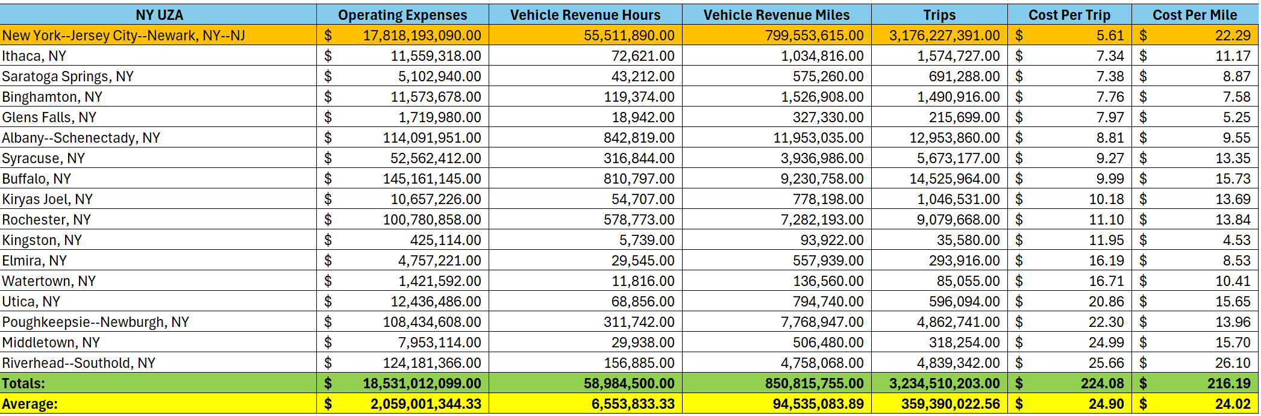
Here are the UZA’s that I’ve personally used by each state and where they rank within their respective states.
I also want to provide insight on how complex the issue is and how much data is associated with this analysis.

Slide 5
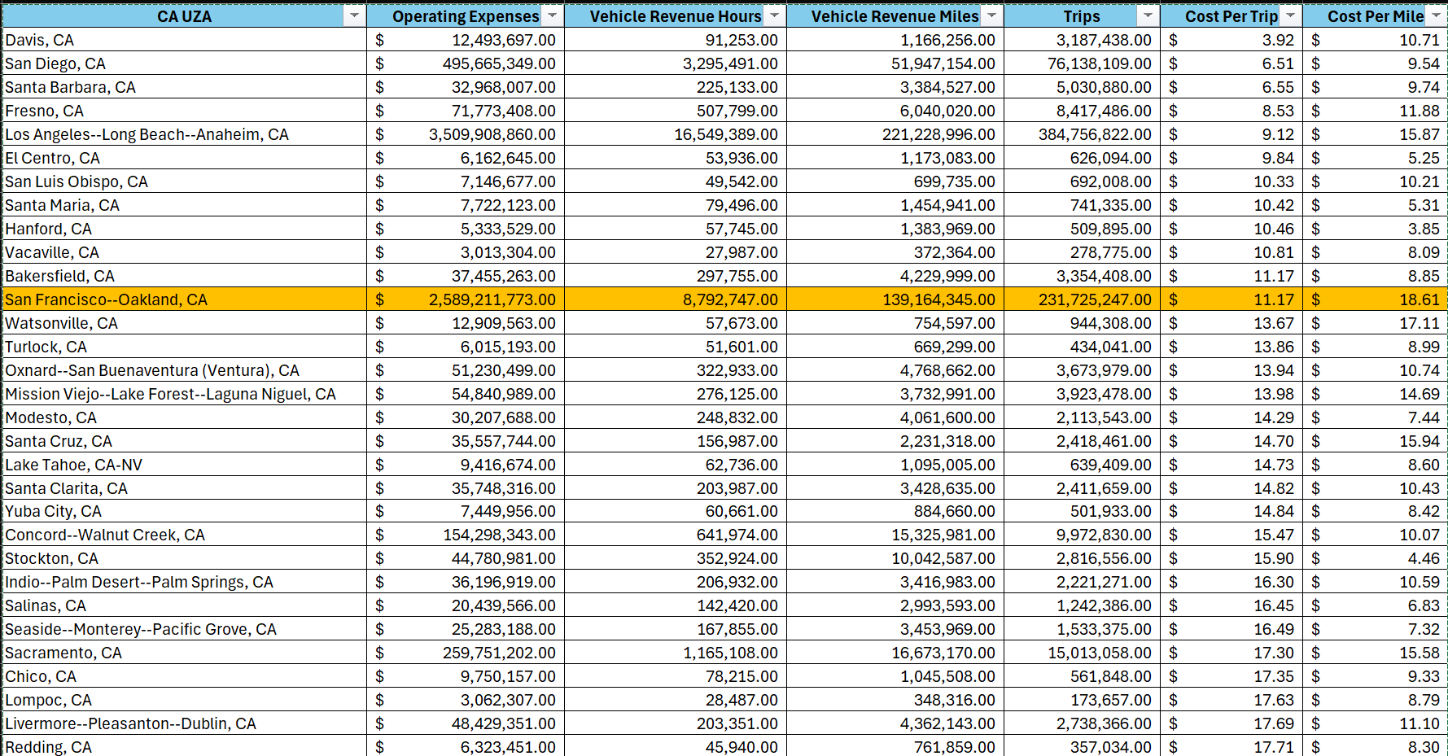
Here are the UZA’s that I’ve personally used by each state and where they rank within their respective states.
I also want to provide insight on how complex the issue is and how much data is associated with this analysis.

Slide 6
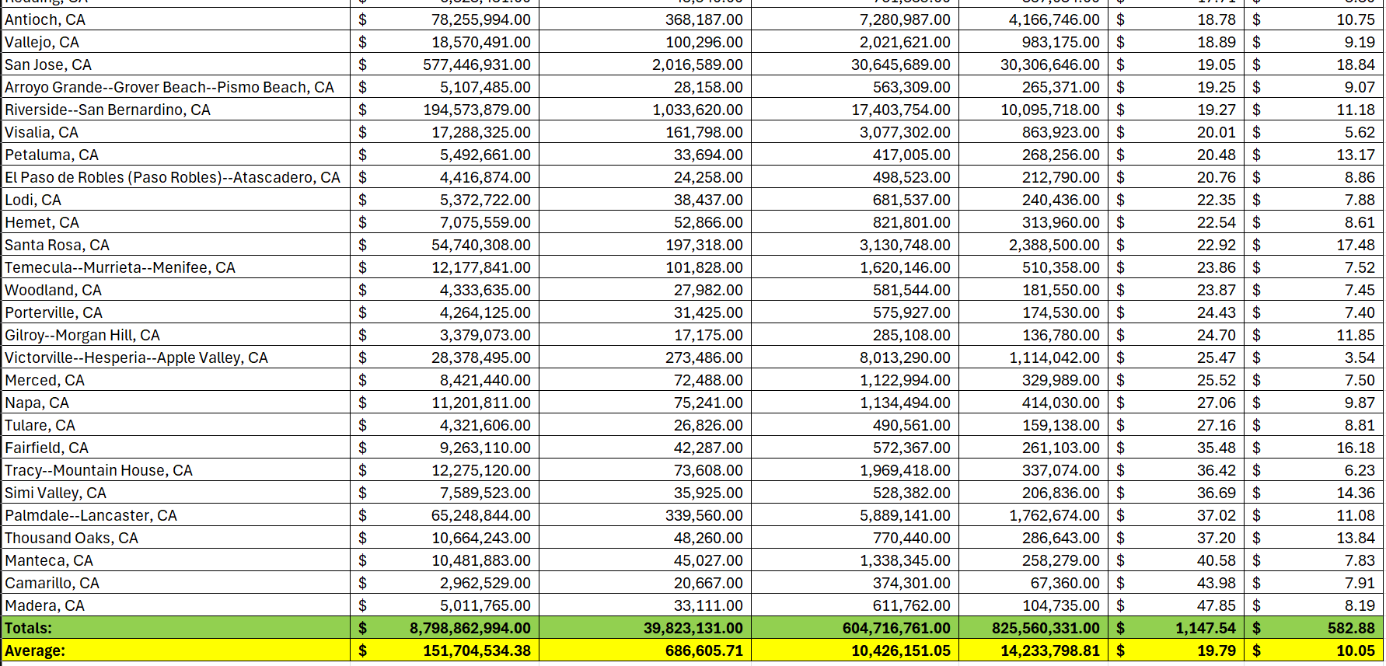
Here are the UZA’s that I’ve personally used by each state and where they rank within their respective states.
I also want to provide insight on how complex the issue is and how much data is associated with this analysis.

Slide 7
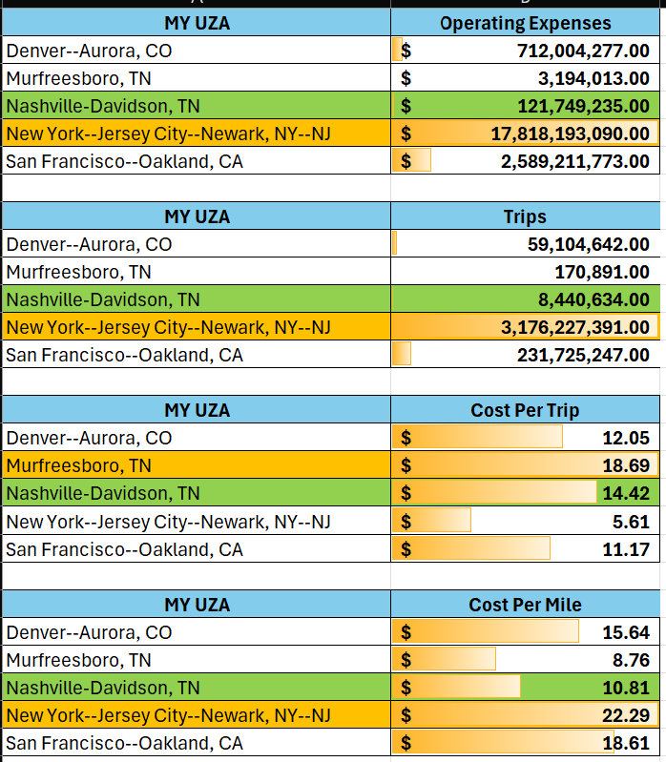
These charts shows how Nashville and Murfreesboro compare in metrics VS the other UZA’s.
Conclusion:
Surprisingly, the Nashville UZA’s perform well when measured by cost per trip or per mile.
Next, we need to see how these numbers compare when the amount of people they serve is factored in.

Slide 8
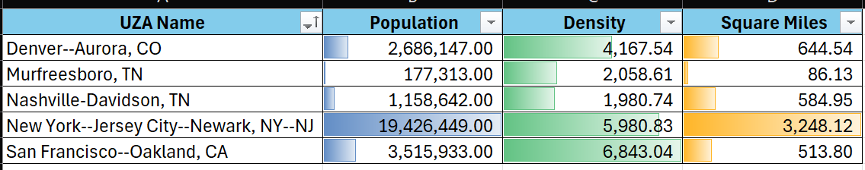
This shows the interesting differences between the 3 categories.
Conclusion:
The square miles and density measurements help us to accurately compare each UZA’s performances against each other even though the population and expenses used are so different.

Slide 9
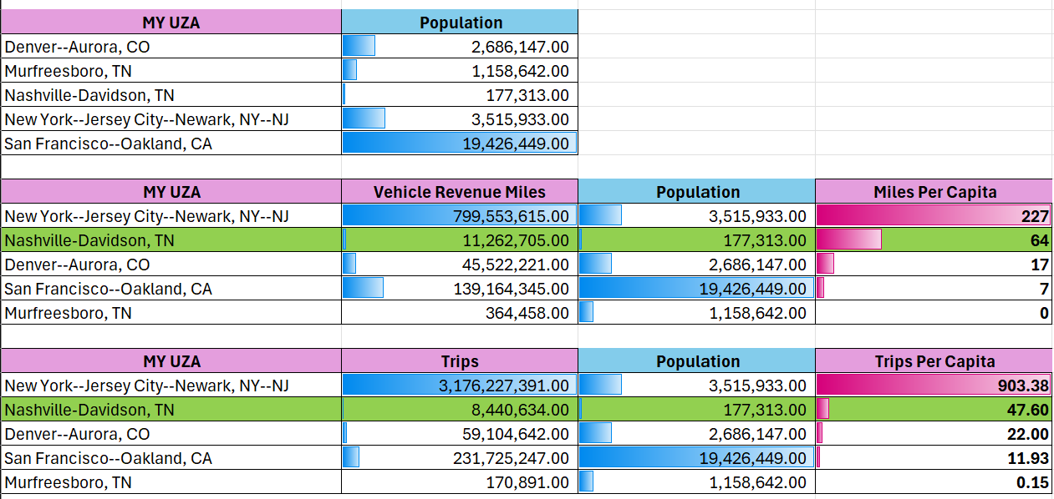
The population information helps us to see how effectively each UZA is serving the population of the area.
Conclusion:
Very surprisingly Nashville is the top performer only behind NYC in miles and trips per capita. I would have never guessed that Nashville performed so much better than the other cities. They are doing better with what they have than the larger UZA’s.

Slide 10
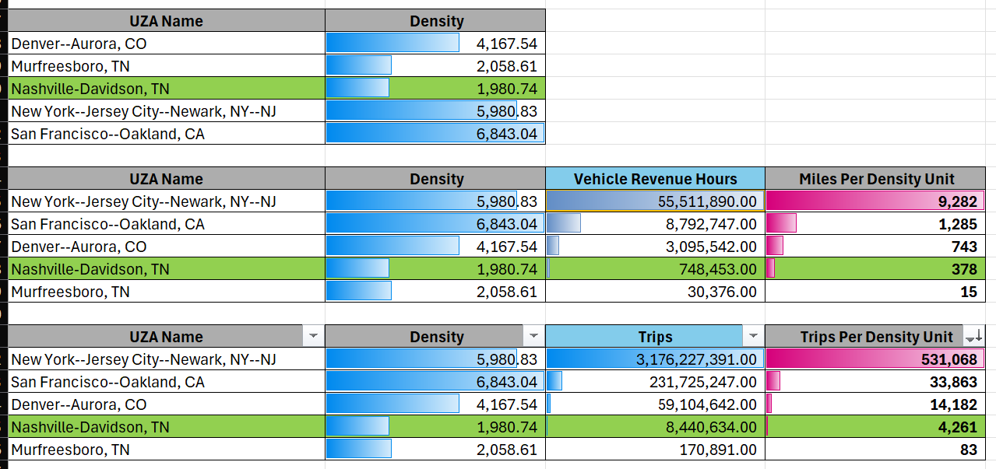
Density is also very useful to measure effectiveness.
This shows how the lack of density in the Nashville area is what causes it to perform poorly/makes me feel that the public transportation system in Nashville is bad.
This shows the importance of density in helping a UZA perform well.

Slide 11
CONCLUSION:
It is not accurate to say that Nashville does not have good public transportation. They are performing surprisingly well with what they have. The issue is that there is no public transportation available for those living in the cities bordering Nashville. This is what is causing the terrible traffic during rush hour. We need public transportation to take people to and from those towns to prevent people from having to drive 1 to 1.5 hours each way just to work.

Slide 12
Where does Nashville place in the cost per trip/mile for population and density compared to ALL of the UZA’s in the US?
Is there a way to show how well/not well they’re using the total expenses?
What is the best way to bring in age group and college degree data within the population to see why this is the case?

